Slide 1

Crime Data(911) - Baltimore
-Suyash Kalwani
-09/30/2024

Slide 2
Data Profile Summary
01
Total Rows: 292761
Total Columns: 16
Total Rows and Columns:
02
CrimeDate and CrimeTime: symbolic/discrete
Crime Code: high occurrences of specific codes, pointing out any potential skewness or imbalance in crime reporting.
Location: Discuss the large number of unique locations and any notable hotspots.
Data Types Identified
03
Significant levels of missing data, such as the 'Weapon' field, “Vr1 name1”.
Missing Data:
Notes:
TABLEAU OPEN SOURCE LINK: https://public.tableau.com/views/SUYASHKALWANIHOMEWORK1/911crimedatadashboard?:language=en-US&publish=yes&:sid=&:redirect=auth&:display_count=n&:origin=viz_share_link

Slide 3
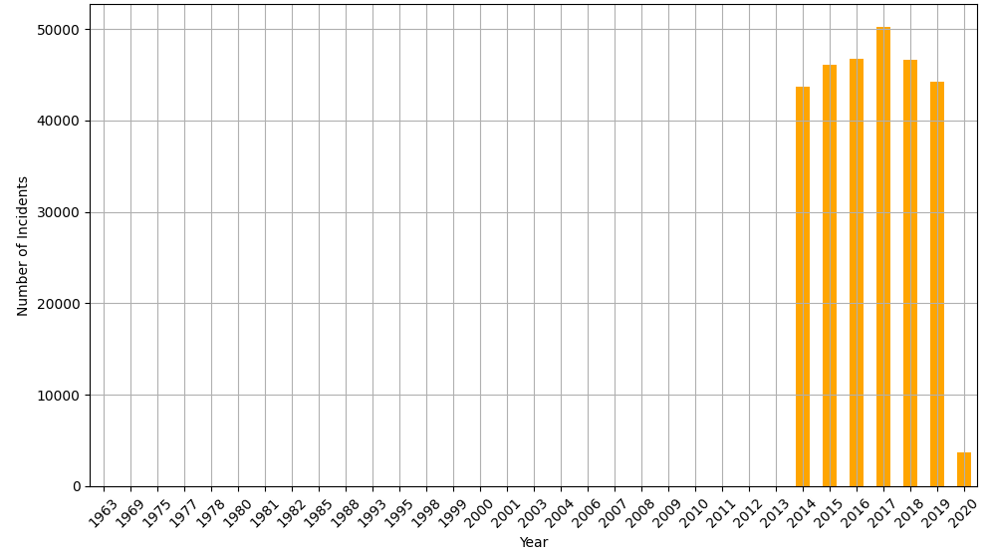
#### 2. The temporal pattern year-to-year trend of crime incidents from all geo-locations
Y-Y Crime incidents
-Notable/Surprising Observations
Peak Crime Years (2014-2019)
Increasing Trend
Sudden Drop (2020) which could be possible due to COVID - 19 Pandemic.
DATA Gaps: The graph shows some gaps in the data, particularly noticeable before the 2014s where the bars are not continuous
Notes:
TABLEAU OPEN SOURCE LINK: https://public.tableau.com/views/SUYASHKALWANIHOMEWORK1/911crimedatadashboard?:language=en-US&publish=yes&:sid=&:redirect=auth&:display_count=n&:origin=viz_share_link

Slide 4
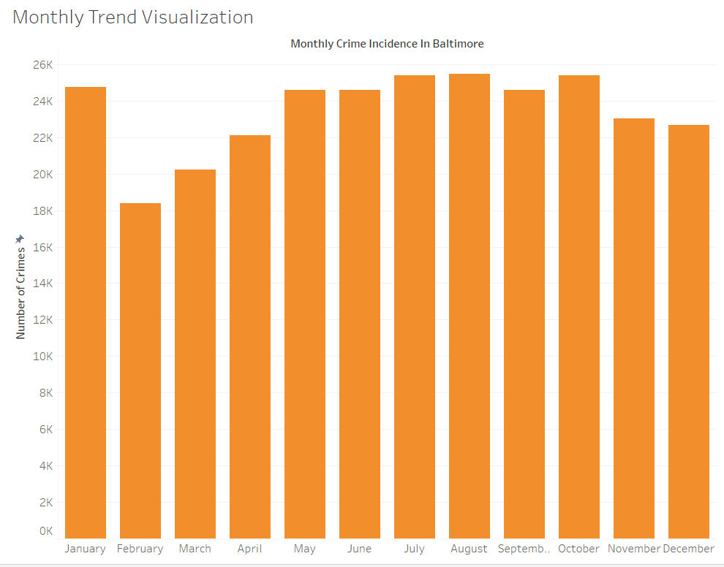
#### 2. The temporal pattern monthly trend of crime incidents from all geo-locations
M-M Crime incidents
-Notable/Surprising Observations
Lowest and Highest Months: February(lowest), July(highest)
End of year decreasing trend.
Seasonal Variations: An increase in crime incidents starting from May, peaking during the summer months (June, July, and August), and then gradually declining towards the end of the year.
Notes:
TABLEAU OPEN SOURCE LINK: https://public.tableau.com/views/SUYASHKALWANIHOMEWORK1/911crimedatadashboard?:language=en-US&publish=yes&:sid=&:redirect=auth&:display_count=n&:origin=viz_share_link

Slide 5
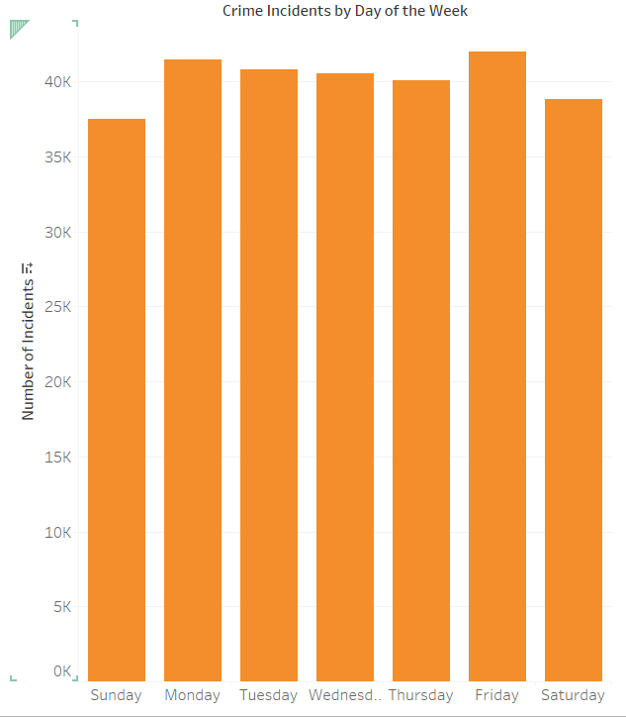
#### 2. Plots to describe the temporal pattern daily classified trend of crime incidents from all geo-locations
Day-Day Crime incidents
-Notable Observations
Uniform Distribution Across Weekdays
Slight Decrease on Weekends
There appears to be a subtle peak on Thursday, which is interesting as it could indicate a midweek increase in specific types of crimes,
Notes:
TABLEAU OPEN SOURCE LINK: https://public.tableau.com/views/SUYASHKALWANIHOMEWORK1/911crimedatadashboard?:language=en-US&publish=yes&:sid=&:redirect=auth&:display_count=n&:origin=viz_share_link

Slide 6
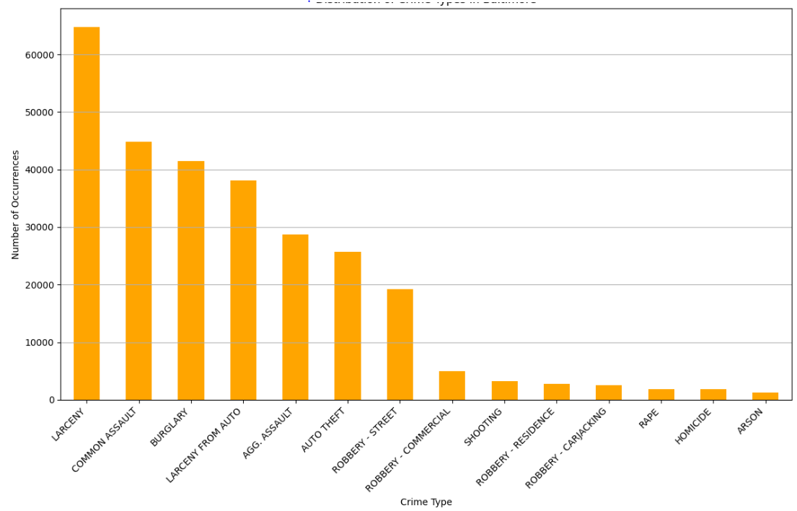
#### 3. A plot describing the distribution of crime type aggregating from all geo-locations and all time periods;
Aggregating Crime Types
-Notable Observations
Dominance of Property Crimes (Larceny, Common Assault and burglary)
Violent Crimes: Most Common Aggravated Assault and Robbery (Street).
Less Frequent Crimes: Arson and Homicide
Notes:
TABLEAU OPEN SOURCE LINK: https://public.tableau.com/views/SUYASHKALWANIHOMEWORK1/911crimedatadashboard?:language=en-US&publish=yes&:sid=&:redirect=auth&:display_count=n&:origin=viz_share_link

Slide 7
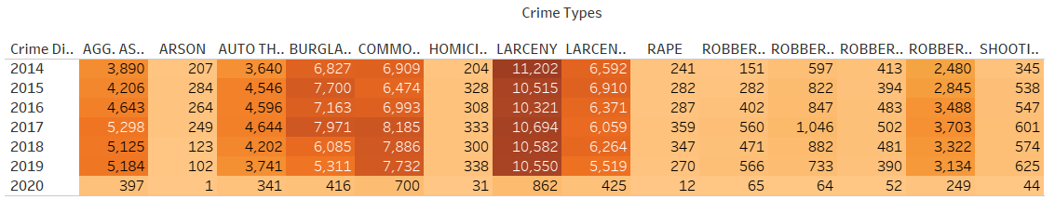
#### 4. YEARLY distribution of crime type aggregating from all geo-locations
Yearly crime type heatmap
-Notable Observations
Fluctuating Overall Trend: An observable increase in certain types of crimes like Aggravated Assault and Larceny Theft
Decline in 2020: This decrease is likely influenced by the COVID-19 pandemic
Burglary and Robbery show peaks around 2017 and then a gradual decline
Notes:
TABLEAU OPEN SOURCE LINK: https://public.tableau.com/views/SUYASHKALWANIHOMEWORK1/911crimedatadashboard?:language=en-US&publish=yes&:sid=&:redirect=auth&:display_count=n&:origin=viz_share_link

Slide 8
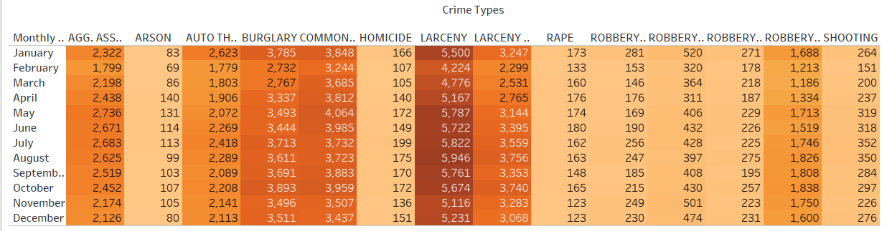
#### 4. Monthly distribution of crime type aggregating from all geo-locations
Monthly crime type heatmap
-Notable Observations
Seasonal Fluctuations: Higher crimes committed in Summer.
High Incidence Months: July being the highest particularly in Larceny and Aggravated Assault
Homicide and Rape show less variation month-to-month compared to property crimes, indicating that these more serious offenses are less influenced by seasonal factors.
Notes:
TABLEAU OPEN SOURCE LINK: https://public.tableau.com/views/SUYASHKALWANIHOMEWORK1/911crimedatadashboard?:language=en-US&publish=yes&:sid=&:redirect=auth&:display_count=n&:origin=viz_share_link

Slide 9
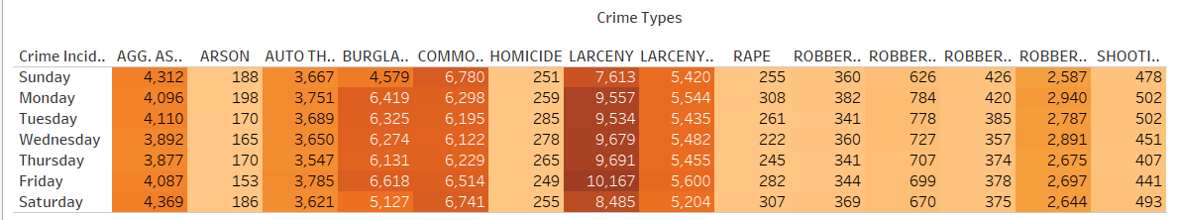
#### 4. Daily distribution of crime type aggregating from all geo-locations
Daily crime type heatmap
-Notable Observations
Sunday shows the highest overall incidence for many crime types, including Homicide, Larceny, and Common Assault.
Consistent Trends Across Days: Larceny consistently records high numbers throughout the week, Burglary shows somewhat consistent figures
Robberies and Shootings are highest on Sundays and Mondays and gradually decreases.
Notes:
TABLEAU OPEN SOURCE LINK: https://public.tableau.com/views/SUYASHKALWANIHOMEWORK1/911crimedatadashboard?:language=en-US&publish=yes&:sid=&:redirect=auth&:display_count=n&:origin=viz_share_link

Slide 10
THANK YOU
Suyash Kalwani
ZC69775
Notes:
TABLEAU OPEN SOURCE LINK: https://public.tableau.com/views/SUYASHKALWANIHOMEWORK1/911crimedatadashboard?:language=en-US&publish=yes&:sid=&:redirect=auth&:display_count=n&:origin=viz_share_link

